Slide 1
Facebook Live Sellers in Thailand
Unsupervised Machine Learning Case Study
By: Ashwin Jaishanker

Slide 2
Title & Objective
Facebook Live Sellers in Thailand Unsupervised Machine Learning Case Study
Objective: Analyze Facebook post engagement and group posts using K-Means clustering to identify performance patterns.
Tools: Python, Pandas, Scikit-learn, Google Colab

Slide 3
Dataset Overview
7050 Facebook posts from 10 Thai sellers
Key features:
Post type
Posting time
Engagement metrics (reactions, comments, shares)
Data preprocessing included:
Datetime conversion
Feature scaling

Slide 4
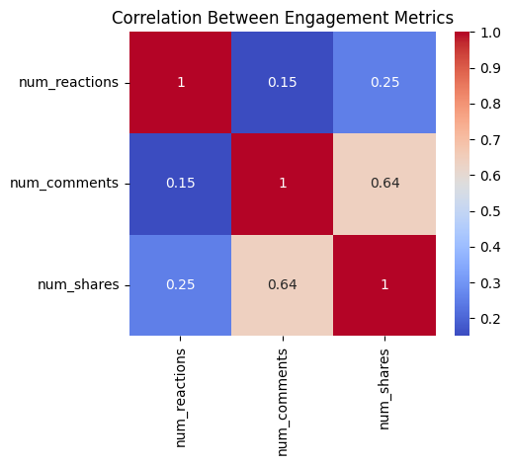
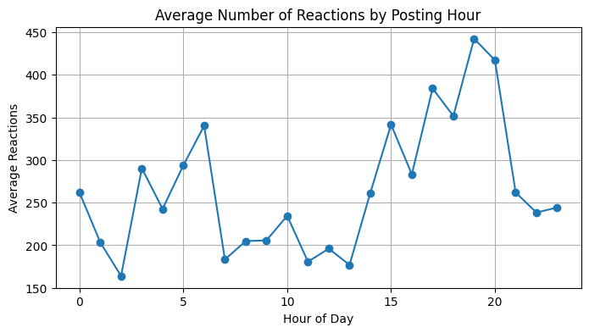
Key Exploratory Insights
Evening & late-night posts receive higher reactions
Strong positive correlation between:
Reactions, comments, and shares
Video posts show the highest average engagement
Strong positive correlation among engagement metrics.
Engagement peaks during evening and late-night hours.

Slide 5
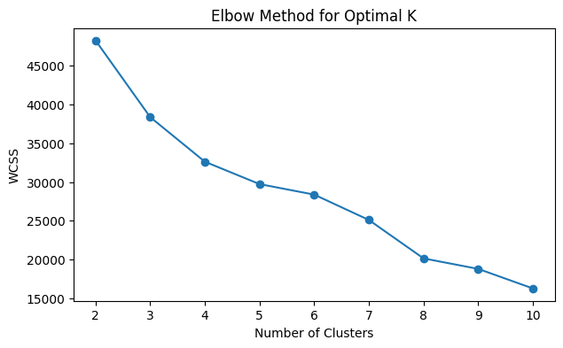
K-Means Clustering Approach
Features used:
Reactions, comments, shares, likes, loves, wow, haha, sad, angry
Data scaled using StandardScaler
Elbow Method used to find optimal clusters
Optimal number of clusters: K = 3
Elbow point suggests an optimal cluster count of K = 3.

Slide 6
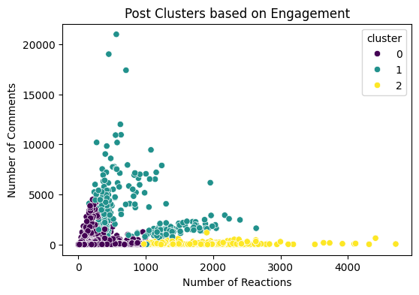
Cluster Interpretation
Cluster | Description
0 | Low engagement posts
1 | Moderate engagement posts
2 | High engagement posts
Insight: High-engagement cluster represents content with strong user interaction and visibility.
Posts are clearly grouped into low, medium, and high engagement clusters.

Slide 7
Conclusion
K-Means effectively segmented posts by engagement level
Video content + optimal timing leads to higher engagement
Businesses can:
Replicate high-performing content
Improve underperforming posts
Conclusion: Unsupervised learning provides actionable insights for content strategy optimization.

